Slide 1

Unit III Engineering Materials Topic: Carbon Nanotubes
Dr. P. G. Umape
Department of Applied Science
Pune Institute of Computer Technology

Slide 2
Learning Outcomes
Students will be able to
Explain and Draw structure of carbon nanotubes.
Classify carbon nanotubes based on their structure.
Discuss properties and applications of carbon nanotubes.

Slide 3
Carbon Nanotubes
Introduction:
As we know graphene is a single layer of graphite.
All the carbon atoms of graphene are SP² hybridized.
The C-C bond length in graphene is 1.42 Å and bond angle is 120º.
The graphene has excellent electrical, thermal and physical properties.
Carbon nanotubes are members of carbon family, which are imagined as cylinders formed by rolling of graphene sheet and ends are capped by hemisphere of fullerene.

Slide 4
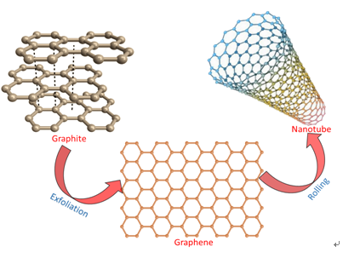
Carbon Nanotubes
Image Source: http://ivyunion.org/index.php/ajt/article/view/1341

Slide 5
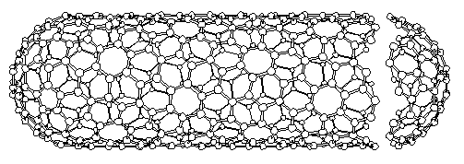
Carbon Nanotubes
Introduction:
CNT is a one dimensional nonmaterial, its has diameter of few nanometer (upto 100 nm), while length ranges from 0.14 nm to 55.5 cm.
Types:
Carbon nanotubes are classified as
1. Single walled (SWCNT).
2. Multi walled (MWCNT).

Slide 6
Carbon Nanotubes Classification
CNT
SWCNT
Armchair
Helical
MWCNT
Zigzag

Slide 7
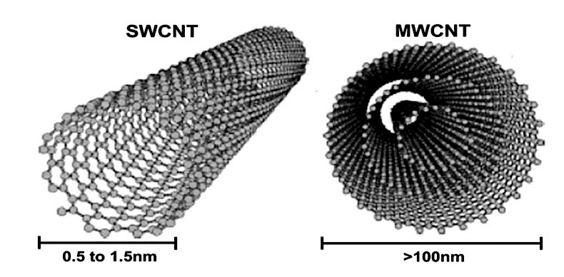
Carbon Nanotubes
1. Single walled (SWCNT).
When carbon nanotubes are made of on single layer of graphene sheet it is called as SWCNT.
2. Multi walled (MWCNT).
When carbon nanotubes are made of on multi layer of graphene sheet it is called as MWCNT. Here number of graphene sheets are folded to form concentric cylinders of graphene.

Slide 8
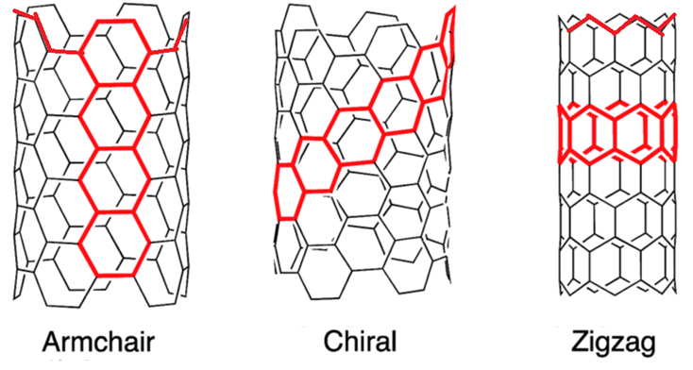
Carbon Nanotubes
SWCNT’S are further classified as
Armchair
Chiral
Zigzag

Slide 9
Carbon Nanotubes
Properties
They can be bent, twisted and flattened into small circle.
Intrinsic, mechanical and transport properties make them
ultimate carbon fiber.
They are stiff, strong.
High thermal and electrical conductivity.
Large surface area and low density.

Slide 10
Carbon Nanotubes
Properties
Armchair and Zigzag are achiral due to their structures.
Helical type is chiral in nature i.e. its mirror image doesn’t coincide with original structure due to its twisted structure.
Its cross section shows cis and trans kinds of carbon arrangement.
Here armchair configuration of CNT is good conductor of electricity
While zig-zag and helical CNT’s are semiconductor in nature.

Slide 11
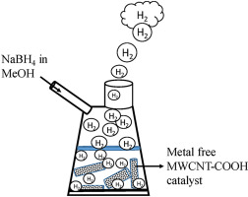
Carbon Nanotubes
Conductivity of CNT :
One dimensional structures and sp² hybridized.
Limited resonance.
Semiconductor character.
Conductivity increased by compounding with alkali metals.
Applications of CNT :
Filtration.
Stereospecific reactions.
As nanocylinders for H₂ gas.
Catalyst in some reactions.

Slide 12
Summary
Definition of CNT’s
Types of CNT’s
Properties of CNT’s
Applications of CNT’s

